Slide 1

Hybrid System for Research Paper Recommendation and Text Summarization
INDRAPRASTHA INSTITUTE OF INFORMATION TECHNOLOGY
An innovative approach for efficient research paper exploration
- Presented by Ranit Pal

Slide 2
Introduction
Problem Statement:
Challenge: Handling exponential growth of online research data.
Time-consuming task: Exploring relevant information in the dedicated research community.
Motivation for the Project:
Growth of internet usage and information generation.
Dedication of the research community and the need for efficient tools.
Introduction to existing challenges in accessing research resources.

Slide 3
Novelty and Contribution
Novelty:
Gap in Existing Systems:
Existing systems recommend papers but lack summarization.
Abstracts are limited and may lack implementation details.
Proposed Solution:
Recommends papers and provides detailed section-wise summaries.
Utilizes a combination of extractive and abstractive summarization.
Contribution:
Unique Features:
Integration of recommendation and summarization.
Re-ranking based on section-wise summaries.
Addressing Challenges:
Overcoming limitations of non-uniform paper formats.
Working within computational power constraints for summary generation.

Slide 4
Methodology
Pre-processing:
Basic NLP pre-processing, including stopword removal, tag removal, lemmatization etc.
Vectorization of corpus and user query.
Recommendation:
Utilizes content-based filtering for paper recommendations.
Cosine similarity calculates relevance.
Text Summarization:
Extractive summarization for section-wise paper summaries.
Combines summaries for a comprehensive overview.
Re-Ranking:
Uses obtained summaries to re-rank recommended papers.
Cosine similarity with title and abstract contributes to re-ranking.
Tools and Libraries Used:
NLP, scikit-learn, Pandas, NumPy, Matplotlib, PyPDF2, Transformers, BeautifulSoup, Spacy.

Slide 5
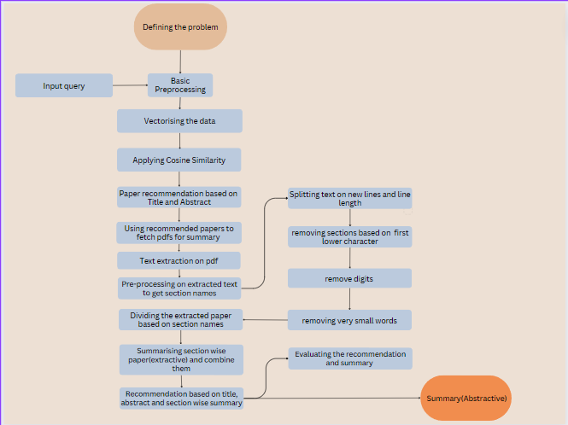
Figure 1 Flowchart of proposed approach

Slide 6
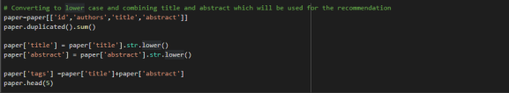
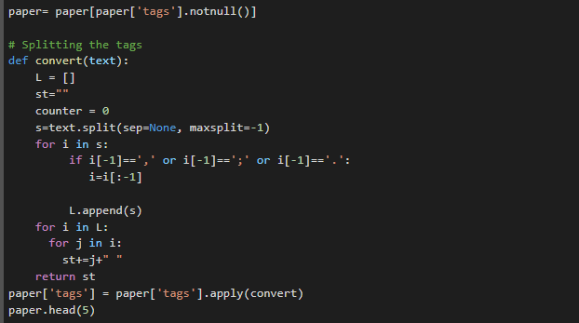
Code Modules:
Pre-processing: Basic NLP pre-processing.

Slide 7
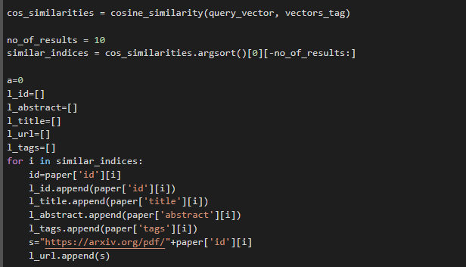
Cosine Similarity: Vectorization and calculation.

Slide 8
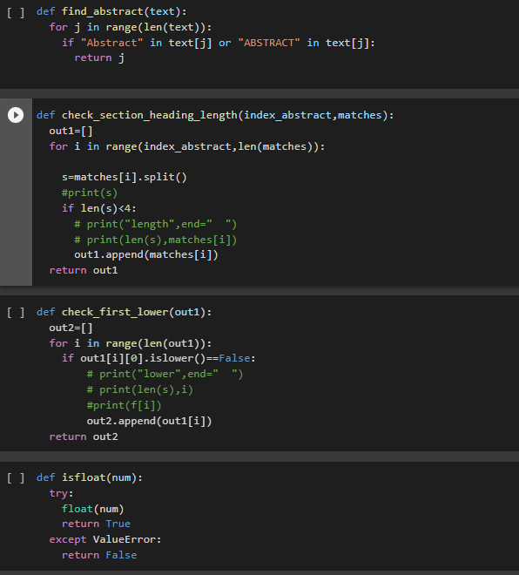
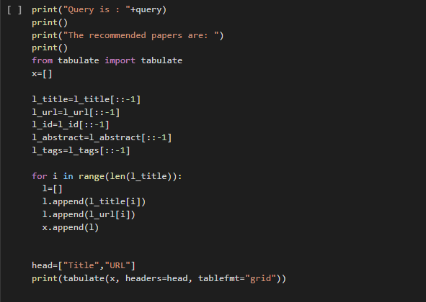
User Input and Evaluation: Query, recommendation model
evaluation.
Summarization: Extractive-based techniques.
Evaluation Metrics:
BLEU score evaluates recommendation effectiveness.
Comparison with existing systems for benchmarking.

Slide 9
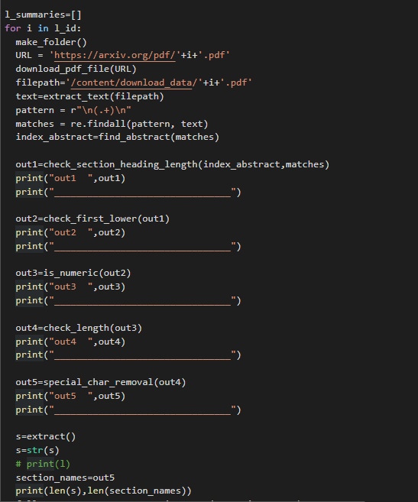
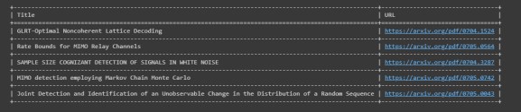
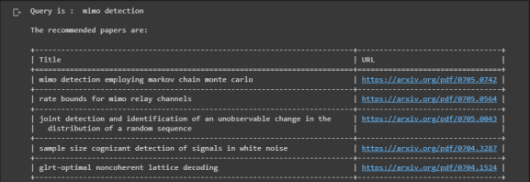
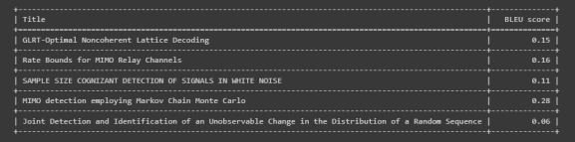

Slide 10
Limitations and Conclusions
Limitations:
Non-Uniform Paper Formats:
Challenge in extracting information consistently.
Adaptability required for varied structures.
Computational Power Constraints:
Resource-intensive task of generating summaries.
Processing limitations may affect performance.
Conclusion:
Summary of Approach:
Implemented a hybrid system for research paper recommendation and text summarization.
Combined content-based filtering and extractive/abstractive summarization techniques.
Contributions:
Addressed the need for a system recommending and summarizing papers.
Providing short and more accurate summary and re-ranking for enhanced user experience.

Slide 11
Thank You

